Slide 1
Case Study – 2016 orders
Business Intelligence Analyst Candidate: Lu Zhang

Slide 2
EDA Process
Questions to Solve
Get the top 10 spenders in 2016
Get second highest order item_total for each user if the user purchased more than once
What factors determine the shipping_cost amount
Import libraries and datasets
Check missing values, duplicates, understand datatypes
Data wrangling
Check distribution
Check correlation
Feature engineering

Slide 3
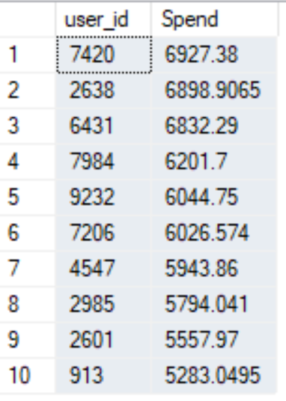
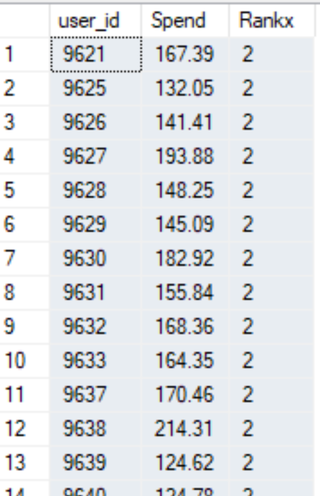
Top 10 spenders in 2016
Second highest order item_total for each user(Partial List)

Slide 4
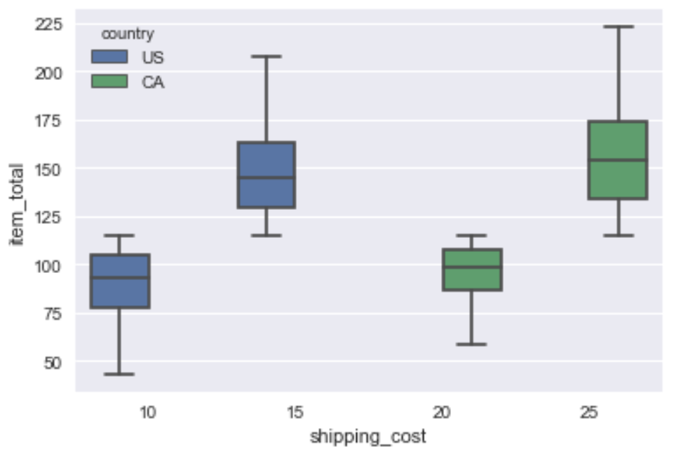
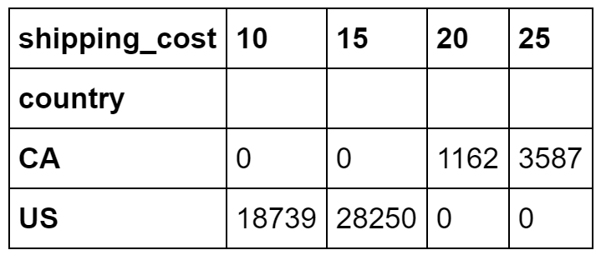
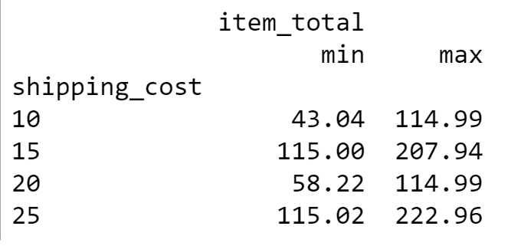
US shipping cost: $10 for item total under $155, $15 for above $155 CA shipping cost: $20 for item total under $155, $25 for above $155
From Crosstable of country by shipping cost, we can see shipping cost for CA is always 20 or 25 and for US is always 10 or 15.
From Boxplot of shipping cost by item total colored by country, we can see for both country, once passing a certain amount of somewhere between 100 and 125, the shipping cost goes to the next level.
From min and max item total of each shipping cost, we can conclude that the splitting point is $115.

Slide 5
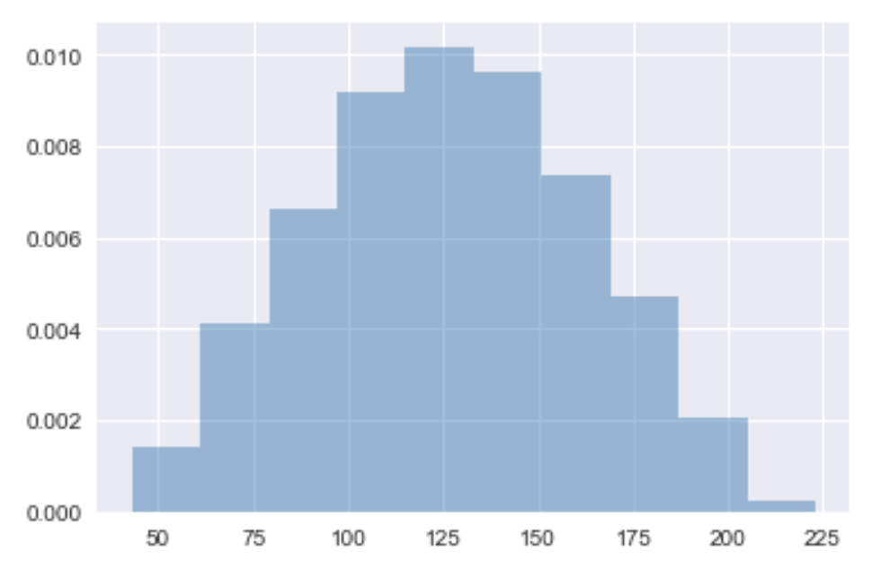
Deal amount is normally distributed. Most orders are around $125.

Slide 6
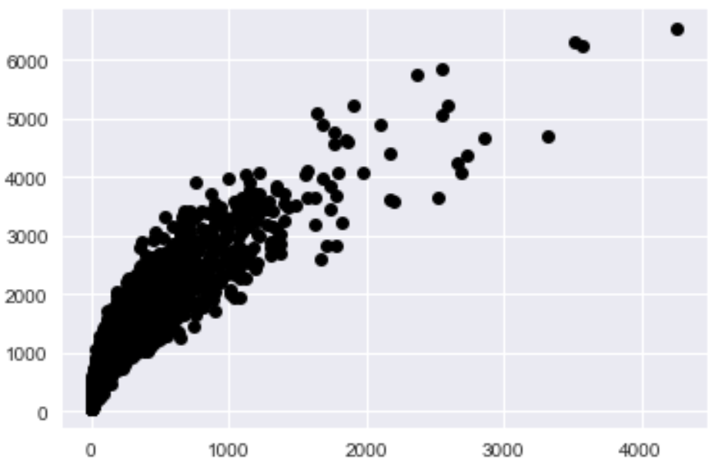
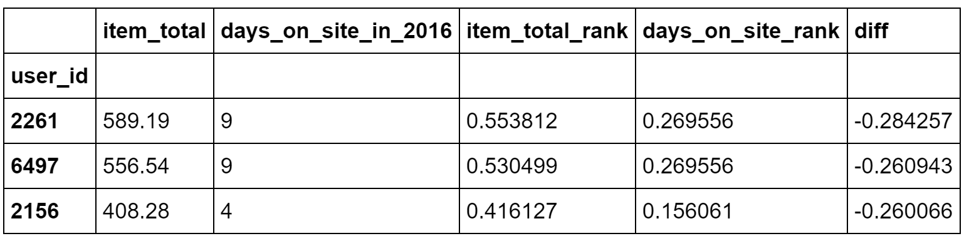
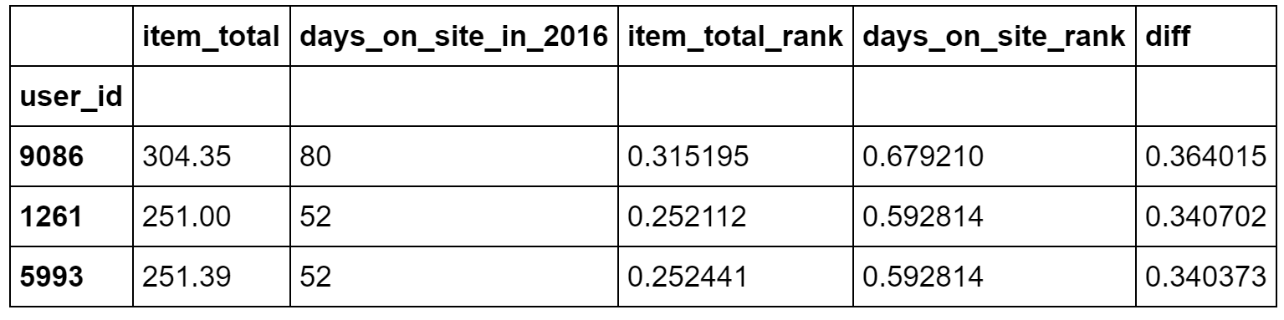
Total item amount and days spent on site are strongly positively correlated
Item Total vs Days on Site
Users who spent short time on site but spent relatively more
Users who spent long time on site but spent relatively less

Slide 7
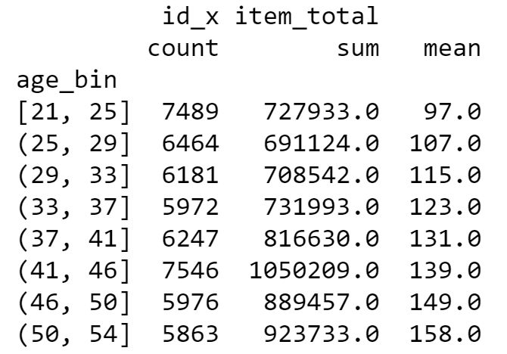
- Age group of (41, 46] contributes the most sales. - Item amount mean increases when age increases.
Item Total vs Age

Slide 8
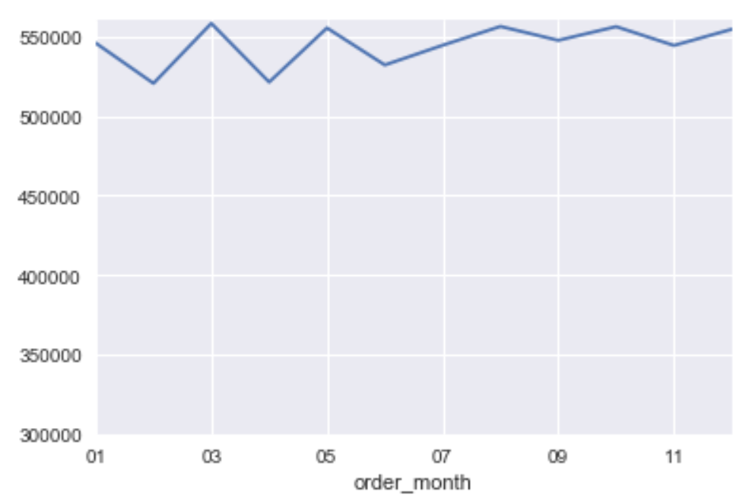
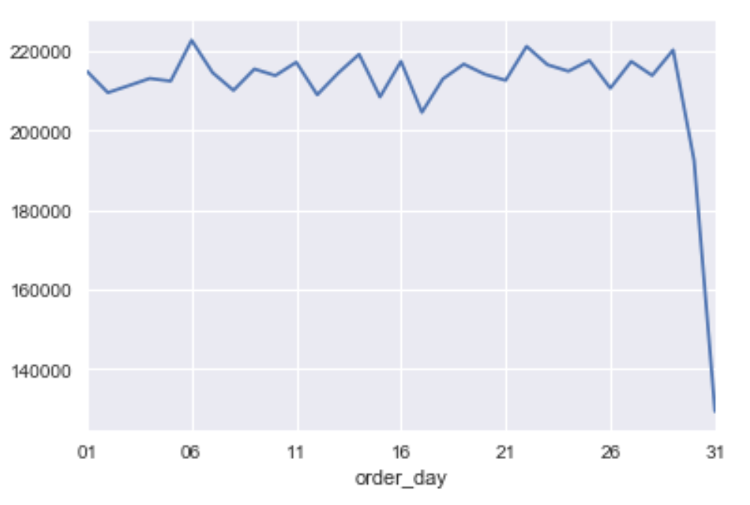
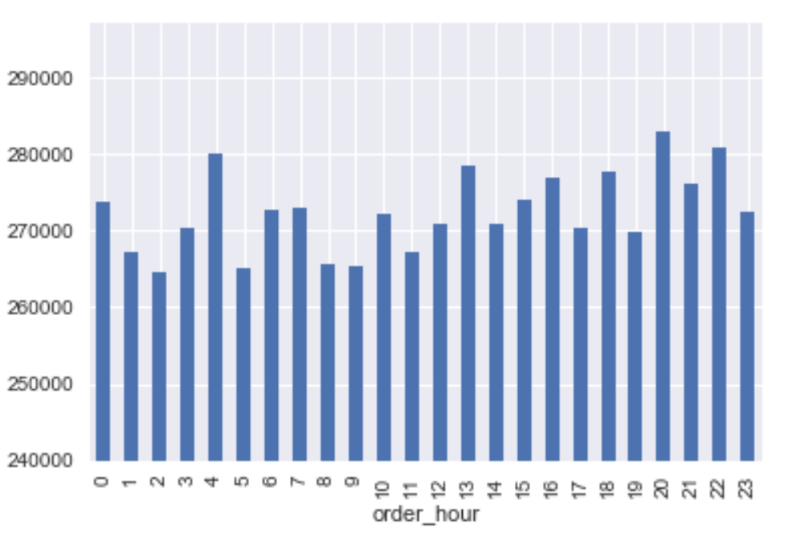
- No obvious seasonality is found. Order amount doesn’t change much over months. For the second half of the year, item total remains high while the first half is slightly more unstable. - Order amount doesn't change much over days (less months have day 31st that’s why there is a drop at the end). - Evening time has slightly more sales than daytime but no obvious peak hour.
Item Total vs Time

Slide 9
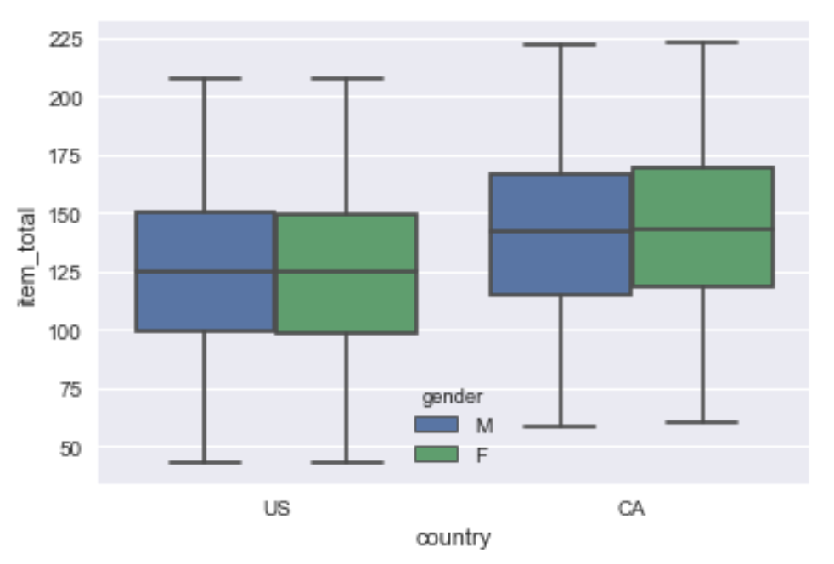
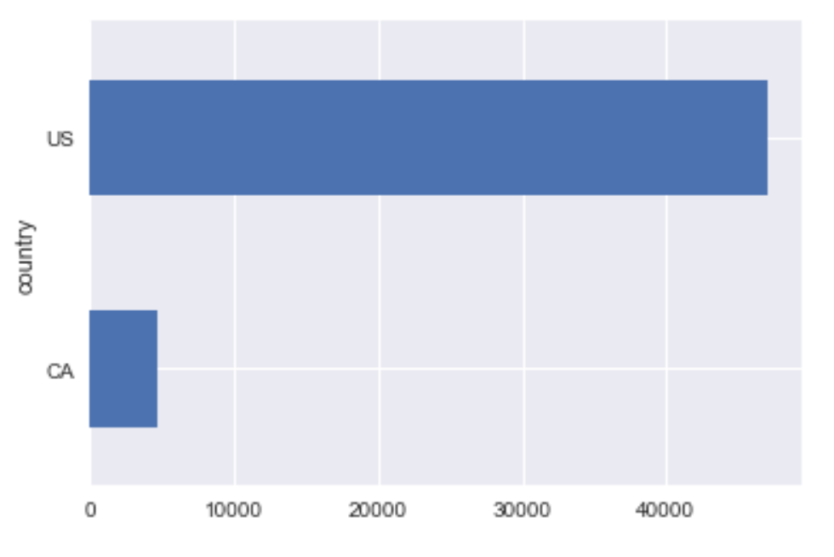
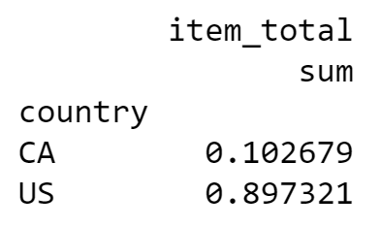
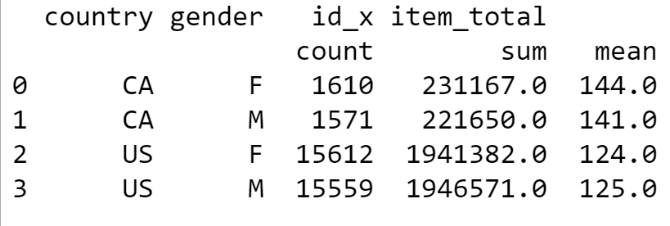
- CA has higher mean of item total than US - No obvious difference between genders
Item Total vs Country and Gender

Slide 10
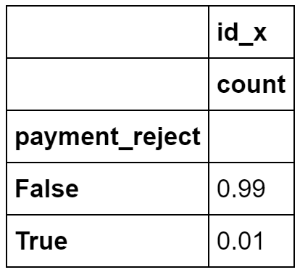
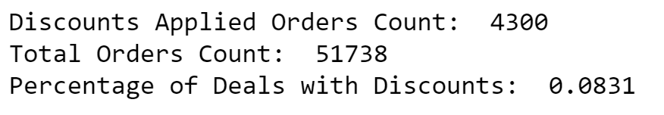
1% of orders got payment rejected
Discount and Reject
8% of orders received discounts

Slide 11
About Candidate Lu Zhang
Skilled business intelligence specialist with 3+ years of experience
Proficient in SQL, Python, R and various BI tools
Strong in translating data into insights and automating repetitive business processes with code
LinkedIn: https://www.linkedin.com/in/lu-zhang-/

